Slide 1
Why choose GCSE Statistics?

Slide 2
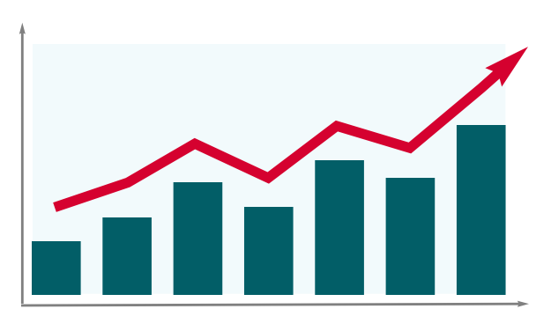
The age of statistics is here!
Statistics and data are becoming more and more prominent in the world around us.
They are being used at an increasing rate in business, politics and science.
If you want to learn about the role statistics plays in all aspects of our lives and how to interpret them, this is the course for you.

Slide 3
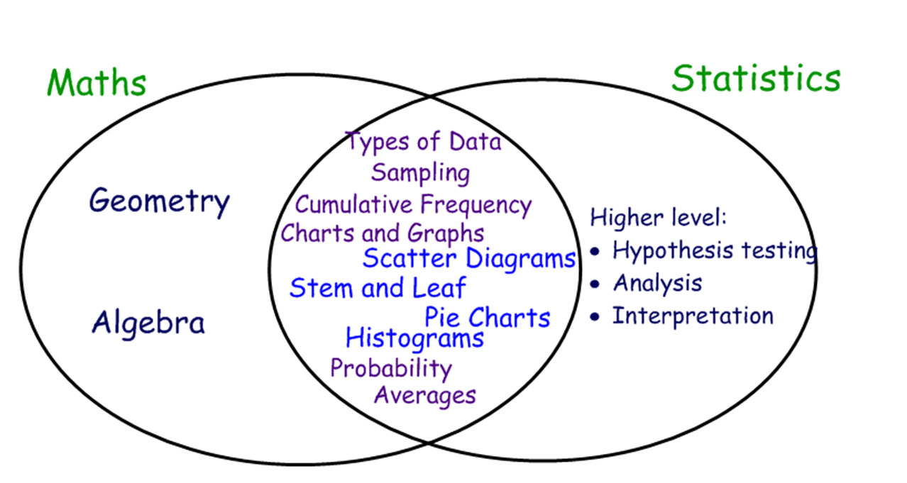
It will help your GCSE Maths!
By studying GCSE Statistics, you will be covering several topics that are in both Maths and Statistics.
You will therefore become a master at them.

Slide 4
2 (or 3) Qualifications from Maths!
We want to set you up with as many great qualifications as possible.
This will help you massively when it comes to applying for colleges/apprenticeships.
You could now get:
2 qualifications from English (Language/Literature)
2 or 3 from Science (Combined [2] /Triple [3])
2 or 3 from Maths (GCSE Maths/Statistics/Further Maths)

Slide 5
It will help your other subjects!
Statistics skills are not only used in Maths, they will be used all over the curriculum!
Now:
Later:

Slide 6
It will help you in your future job!
Statistics are being used more and more in all jobs, here are just a few areas that use them ALOT

Slide 7
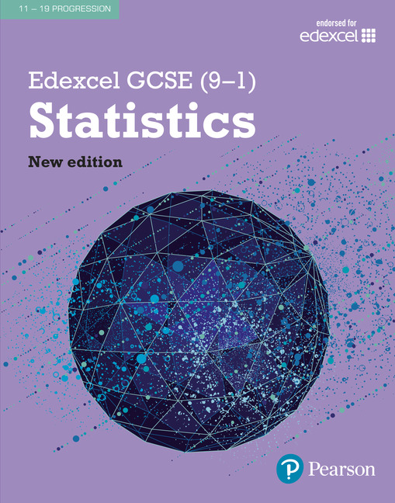
What will I learn?
GCSE Statistics focuses on 3 main areas:
The collection of data.
Processing, representing and analysing data.
Probability.
The units you will study are:
Unit 1: Collection of Data | Unit 5: Time Series
Unit 2: Processing and Representing Data | Unit 6: Probability
Unit 3: Summarising Data | Unit 7: Index Numbers
Unit 4: Scatter Diagrams and Correlation | Unit 8: Probability Distributions

Slide 8
How will I be assessed?
There are two written exam at the end of year 11:
Paper 1 | Paper 2
80 Marks (50%) | 80 Marks (50%)
1 hour 30 minutes | 1 hour 30 minutes
Calculator Allowed | Calculator Allowed

Slide 9
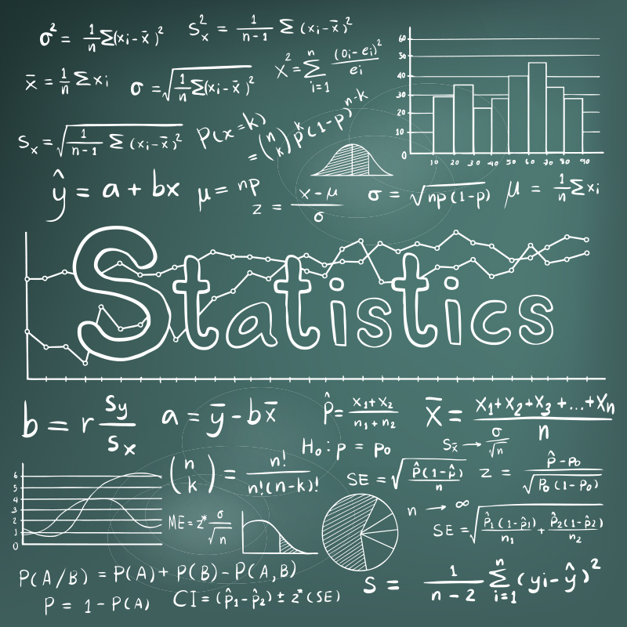
Should I choose GCSE Statistics?
If you are an above average mathematician and enjoy:
Mathematical subjects
Statistics topics (such as charts, graphs and averages)
Probability topics
Then this course is for you.
See Mr Hannard in 130 if you have any questions

